Slide 1

PRESENTED BY
AAMLEEN AHMED,
SUFYAN AZAM
NETWORK SECURITY
TRANSPOSITION MATRIX ENCRYPTION

Slide 2

INTRODUCTION
- Transposition Matrix Encryption is a sophisticated cryptographic method employed to secure sensitive data during transmission and storage.
- Unlike traditional encryption techniques, this method involves rearranging the order of characters in a message based on a matrix key, adding a unique layer of complexity and security.
- It is particularly essential in network security scenarios where safeguarding information from unauthorized access is paramount.

Slide 3
01.
Encryption
FUNCTIONALITIES
02.
Decryption
In this project, our primary objectives revolve around implementing and demonstrating the three main functionalities of Transposition Matrix Encryption: encryption, decryption, and a robust brute force attack mechanism, all bolstered by a modified SHA-256 hash for enhanced data security.
Brute Force Attack
03.

Slide 4
ENCRYPTION STEPS
RandomKey Generation
Hash Value Calculation
Transposition
Matrix
Append & Encrypt

Slide 5

HASH VALUE CALCULATION (SHA256 MODIFIED)
SHA-256 (Secure Hash Algorithm 256-bit) generates a fixed-size, 256-bit (32-byte) hexadecimal hash value of the plain text to be encrypted.
Modification:
We convert each 4-bit packet from 256 bit stream, into an alphabet from the character set of (a-z).
so: 0000 -> a ........... 1111 -> p
So our hash is from the character set [a-p]
e.g.: kemfajblbhognpbgjjfppbjgfkijpaahcclpdlaikggnkodibmgebblnggeoioml

Slide 6

TRANSPOSITION MATRIX & KEY
The Key is a numeric sequence randomly generated for each message, between a length of [5 - 9]. The numeric digits are between [0-key_length).
The characters of updated plain text, i.e. original plain text + hash_value are then entered in the transposition matrix, which is an nxm matrix, where m (columns) is the key length.
Blank space characters are entered between the original plain text and hash value, to fill the transposition matrix completely.
So complete to be encrypted text becomes: original + blank characters + ‘#’ + hash_value

Slide 7

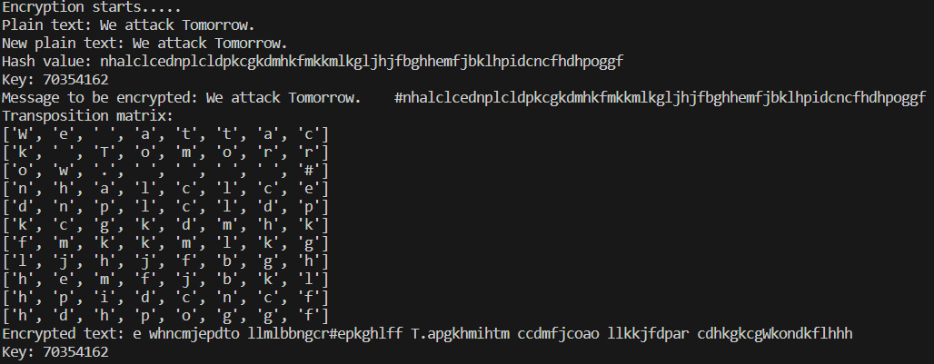
ENCRYPTION
The Transposition Matrix and the key generated is then used to encrypt.
Based on the order of Key digits, the columns are read, and characters from the whole column are added at once to the cypher text.
e.g. for key: 372, the order of reading the column is: 3rd -> 1st ->2nd
WORKING ...

Slide 8
DECRYPTION STEPS
Remake
Transposition Matrix
Decrypt
&
Extract Hash, Text
VerifyHash Value

Slide 9

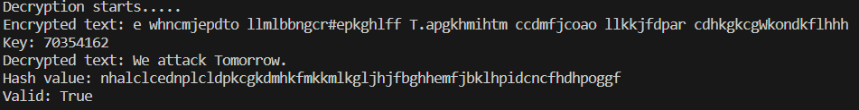
DECRYPTION
Encrypted Message is received, along with the keys on another master channel.
Using the key, the transposition matrix is constructed in a reverse manner as done in the encryption stage.
If the first numeric has order 3, then the first packet of m length (m being no. of rows), will be inserted in column 3.
The Transposition Matrix is then read row-wise, and then the encrypted message is generated accordingly.

Slide 10

HASH VALUE VERIFICATION
After decrypting, the decrypted message is then split using the ‘#’ delimiter. The hash value is in the later part of the message.
The hash value of the plain text decrypted is calculated again using the same hash function.
If the calculated hash value and the appended hash value in message, matches then the message is intact and verified, else there has been some loss.

Slide 11
BRUTE FORCE ATTACK
Generate Permuations of Key
Try last succesful key
Verify Hash value

Slide 12
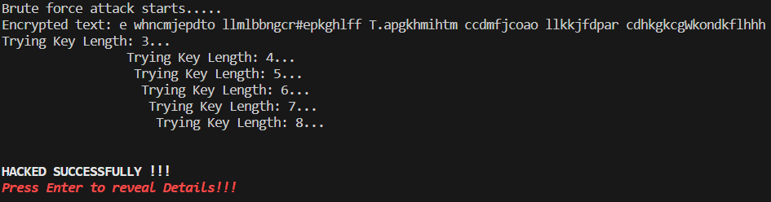
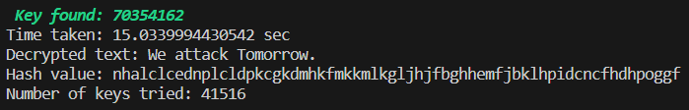
GENERATE ALL PERMUTATIONS
Start with the brute-force attack with the key cracked in the last attack (if any), else None.
Decrypt the cypher text using the guessed key. Calculate the hash value of the extracted plain text and match it with the hash value present in the text.
If verification passes, the key is found, break the loop and return.
If verification fails, the next permutation of the key length is generated. Once all possible permutations are tried, move to the next key length, in a circular fashion, i.e. till we generate the same key which we started with.

Slide 13

PRESENTED BY
AAMLEEN AHMED (2020002)
MOHAMMAD SUFYAN AZAM (2020312)
THANK YOU VERY MUCH!
NETWORK SECURITY - PROJECT 2

